Slide 1
Lecture 4 Array Sorting, Merging

Slide 2
Contents
Bubble Sort
Merge Sort

Slide 3
Sorting
There different kind of Sorting. Today we will see a new kind of sorting called “Bubble Sort”.
Some other kinds of sorting are:
Quick Sorting
Insertion Sorting
Selection Sorting
Merge Sorting
Radix Sorting.

Slide 4
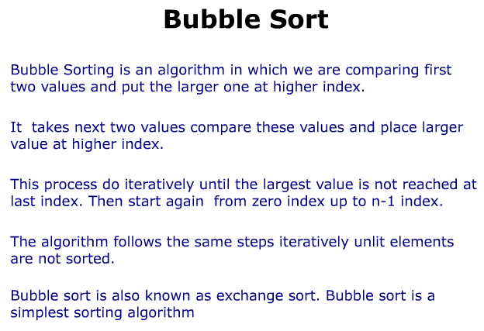

Slide 5
Sorting : Bubble sort
Sorting takes an unordered collection and makes it an ordered one.
1 2 3 4 5 6
77
42
35
12
101
5
1 2 3 4 5 6
5
12
35
42
77
101

Slide 6
"Bubbling Up" the Largest Element
Traverse a collection of elements
Move from the front to the end
“Bubble” the largest value to the end using pair-wise comparisons and swapping
1 2 3 4 5 6
77
42
35
12
101
5

Slide 7
"Bubbling Up" the Largest Element
Traverse a collection of elements
Move from the front to the end
“Bubble” the largest value to the end using pair-wise comparisons and swapping
Swap
1 2 3 4 5 6
42
77
77
42
35
12
101
5

Slide 8
"Bubbling Up" the Largest Element
Traverse a collection of elements
Move from the front to the end
“Bubble” the largest value to the end using pair-wise comparisons and swapping
1 2 3 4 5 6
Swap
35
77
42
77
35
12
101
5

Slide 9
"Bubbling Up" the Largest Element
Traverse a collection of elements
Move from the front to the end
“Bubble” the largest value to the end using pair-wise comparisons and swapping
1 2 3 4 5 6
Swap
12
77
42
35
77
12
101
5

Slide 10
"Bubbling Up" the Largest Element
Traverse a collection of elements
Move from the front to the end
“Bubble” the largest value to the end using pair-wise comparisons and swapping
1 2 3 4 5 6
42
35
12
77
101
5
No need to swap

Slide 11
"Bubbling Up" the Largest Element
Traverse a collection of elements
Move from the front to the end
“Bubble” the largest value to the end using pair-wise comparisons and swapping
1 2 3 4 5 6
Swap
5
101
42
35
12
77
101
5

Slide 12
"Bubbling Up" the Largest Element
Traverse a collection of elements
Move from the front to the end
“Bubble” the largest value to the end using pair-wise comparisons and swapping
1 2 3 4 5 6
101
42
35
12
77
5
Largest value correctly placed

Slide 13
"Bubbling Up" the Largest Element
Notice that only the largest value is correctly placed
All other values are still out of order
So we need to repeat this process
1 2 3 4 5 6
101
42
35
12
77
5
After n-1 comparisons
Largest value correctly placed

Slide 14
Repeat “Bubble Up” How Many Times?
If we have N elements…
And if each time we bubble an element, we place it in its correct location…
Then we repeat the “bubble up” process
N – 1 times.
This guarantees we’ll correctly place all N elements.

Slide 15
“Bubbling” All the Elements
1 2 3 4 5 6
42
35
12
77
5
101
1 2 3 4 5 6
35
12
42
5
77
101
1 2 3 4 5 6
N - 1
12
35
5
42
77
101
1 2 3 4 5 6
12
5
35
42
77
101
1 2 3 4 5 6
5
12
35
42
77
101

Slide 16
Reducing the Number of Comparisons
1 2 3 4 5 6
77
42
35
12
101
5
1 2 3 4 5 6
42
35
12
77
5
101
1 2 3 4 5 6
35
12
42
5
77
101
1 2 3 4 5 6
12
35
5
42
77
101
1 2 3 4 5 6
12
5
35
42
77
101

Slide 17
Bubble Sort Algorithm
procedure bubbleSort( A : list of sortable items )
n = length(A)
repeat
swapped = false
for i = 1 to n-1 inclusive do
/* if this pair is out of order */
if A[i-1] > A[i] then
/* swap them and remember something changed */ swap( A[i-1], A[i] )
swapped = true
end if
end for
until not swapped
end procedure

Slide 18
Main Part of Codes
Let int array[10]={….}, c,d; Here n=10 , Then :
for (c = 0 ; c < ( n - 1 ); c++)
{
for (d = 0 ; d < n - c - 1; d++)
{
if (array[d] > array[d+1])
/* For decreasing order use < */
{
swap = array[d];
array[d] = array[d+1];
array[d+1] = swap;
}
}
}

Slide 19
Bubble Sort Complexity
Case 1) O(n) (Best case) This time complexity can occur if the array is already sorted, and that means that no swap occurred and only 1 iteration of n elements
Case 2) O(n^2) (Worst case) The worst case is if the array is already sorted but in descending order. So, n-1 comparisons will be done in 1st pass, n-2 in 2nd pass, n-3 in 3rd pass and so on. So the total number of comparisons will be
= n + (n – 1) + (n – 2) ... + 1 = (n*(n + 1))/2 = O(n^2)

Slide 20
Summary
“Bubble Up” algorithm will move largest value to its correct location (to the right)
Repeat “Bubble Up” until all elements are correctly placed:
Maximum of N-1 times
We reduce the number of elements we compare each time one is correctly placed

Slide 21
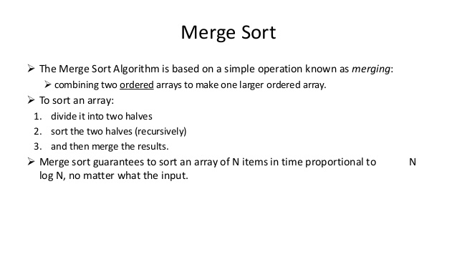
Merge

Slide 22
Questions?

